Slide 1
Genvinset® COVID-19 kit
October 2020

Slide 2
Intended use
General features
Detected genes
Workflow
Validated qPCR thermal-cyclers
Components
Reaction setup
Results interpretation and examples
2

Slide 3
Intended use
Qualitative detection of the novel coronavirus (SARS-CoV-19) ORF1ab and N genes.
Auxiliary diagnosis of suspected coronavirus infection in relevant cases of pneumonia.
3

Slide 4
General features
Easy to use, labor and time saving.
Sample preservation buffer included, separately.
No RNA extraction optional: reduces de risk of exposure.
Multiplex detection of ORF1ab gene, N gene and Internal Control (IC).
Internal Control (IC) included in the lysis buffer to monitor false negatives.
Specimen type: throat swab and sputum.
Storage: -70ºC.
4

Slide 5
Detected genes
TARGET GENES
Gene | Detection channel | Absorption/Emission (nm)
ORF1ab | FAM | 494/518
N | Cy5 | 643/667
INTERNAL CONTROL
Gene | Detection channel | Absorption/Emission (nm)
IC | HEX/VIC | 535/556
5

Slide 6
Workflow
Lysis buffer
Sample (with preservation medium)
Option A)
STEP 1
STEP 2
Lysis buffer
Option B)
Extracted RNA
STEP 1
STEP 2
RNA extraction reagents not included
6

Slide 7
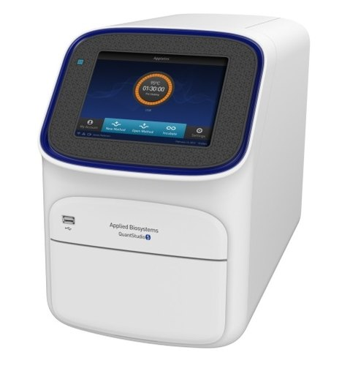
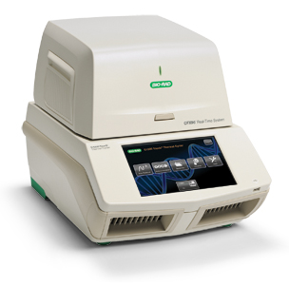
Validated qPCR thermal-cyclers
Thermo Scientific (ABI) QuantStudioTM 5 DX
Bio-Rad CFX96TM DX
6

Slide 8
Components
Sample Preservation solution
Sample Preservation Solution (700 µl x 48)
Reagent Components
RT-PCR Reagent (1,70 ml x 1)
Enzyme Mixture (100 µl x 1)
Negative Control (110 µl x 1)
Positive Control (110 µl x 1)
Lysis Buffer* (300 µl x 1)
* Internal Control (IC) inside
7

Slide 9
Reaction setup
PCR Mix
33 µl RT-PCR Reagent
2 µl Enzyme Mixture
35 µl/sample
35 µl PCR Mix
10 µl sample (or NC or PC) 5 µl Lysis Buffer
Total volume/reaction: 50 µl
8

Slide 10
Results interpretation and examples
Detection of ORF1ab gene (FAM), N gene (CY5) and Internal Control (HEX/VIC) in one tube at the same time.
Possible causes: existence of inhibitors in the PCR process. 2. Elevated RNA concentrations could inhibit the amplification of IC, resulting in weak or negative results.
9

Slide 11
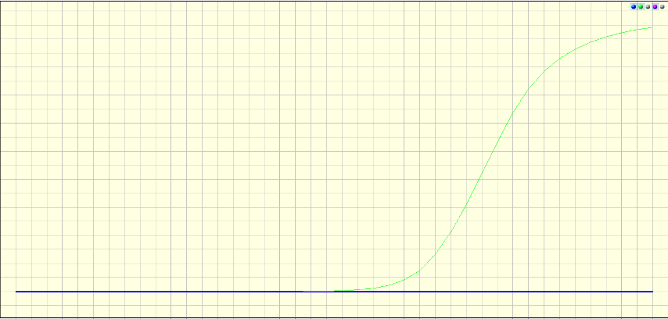
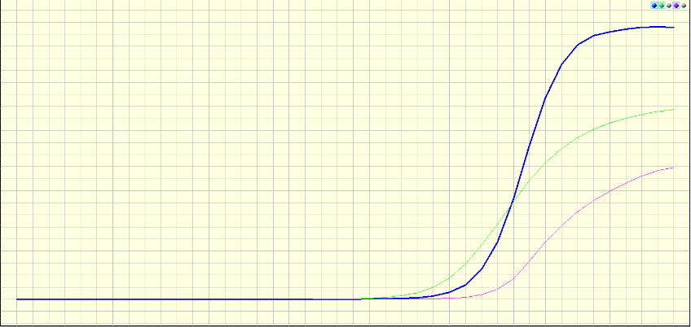
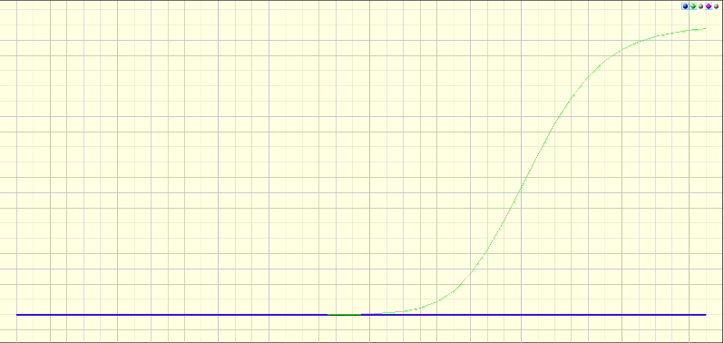
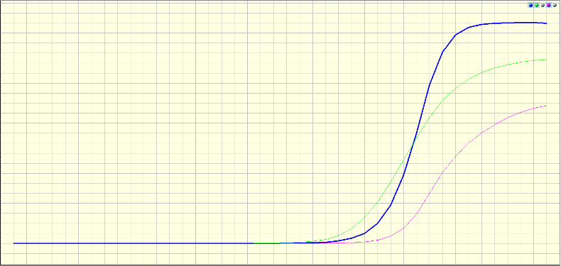
Results interpretation and examples
Without RNA extraction (just buffer lysis):
With RNA extraction:
Internal Control
ORF1ab gene
N gene
10

Slide 12
Contact information
Blackhills Diagnostic Resources S.L.U.
Camino del Pilón 86, casa 7, local
50011 Zaragoza (SPAIN)
+34 976 094 603
www.bdrdiagnostics.com
info@bdrdiagnostics.com

